Slide 1
Definitions
Ecology the study of interactions between organisms and their biotic and abiotic environments
Evolution change in heritable characteristics of populations over successive generations
Fitness average contribution to the gene pool by individuals with a given genotype of phenotype
Selection differential fecundity and survival due to differences in phenotype
Wikipedia, 2019

Slide 2
Learning goals
Understand how evolution and population dynamics are linked via mathematical models

Slide 3
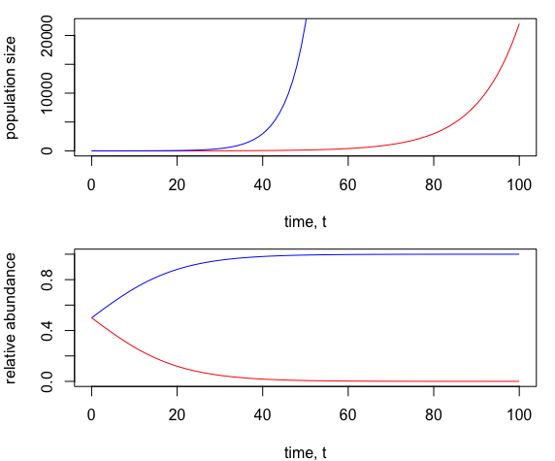
Evolution in populations with no density dependence

Slide 4
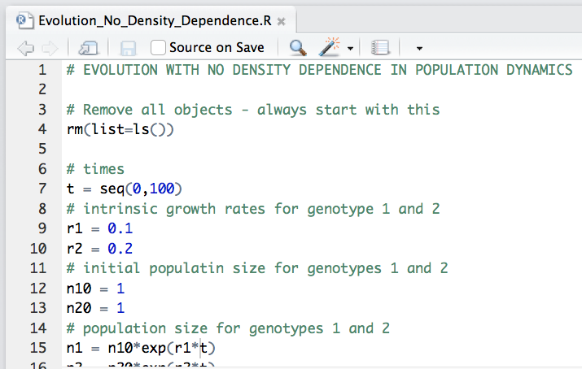

Slide 5
Evolution when population dynamics are density-independent are not very interesting
The choice of the trait that evolves is obvious/doesn’t matter
Trade-offs between life history components don’t matter/aren’t interesting
There is no interaction between genotypes
The evolutionary dynamics are unsurprising
Let’s consider evolution when population dynamics follow continuous time logistic growth!

Slide 6
Learning goals Evolution in populations with density dependence
Argue a hypothesis relating to offspring number and quality given density-dependent population growth
Appreciate the importance of assumptions concerning which traits can evolve
Appreciate the bias introduced from the logistic equation parameterization
Describe an experimental set-up that might test a hypothesis

Slide 7
Evolution in populations with density-dependent population growth
Hypothesis
at low density, genotypes that produce many offspring are selected (r-selected)
at high density, genotypes that produce high quality offspring (strong competitors) are selected (K-selection)
Trade-off between number of offspring and quality

Slide 8
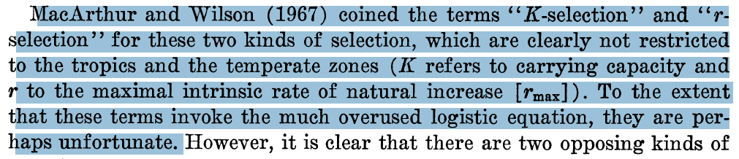

Slide 9
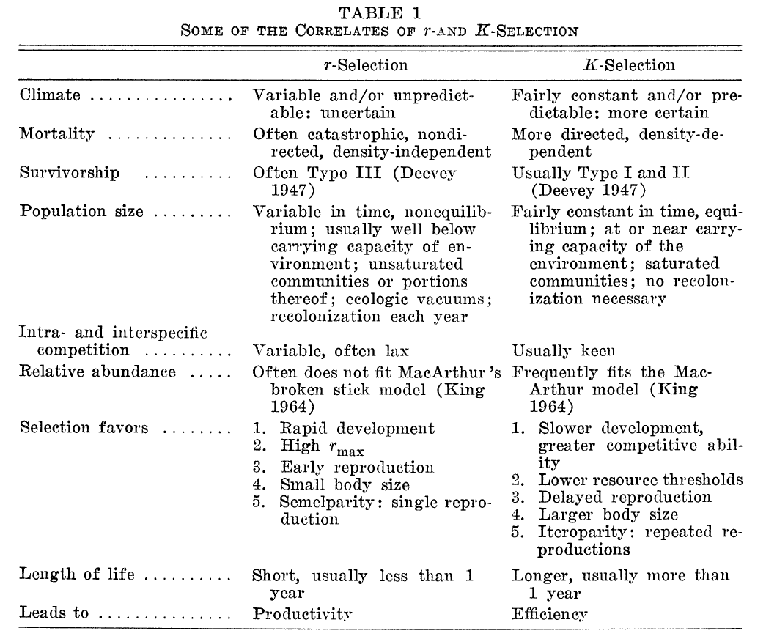

Slide 10
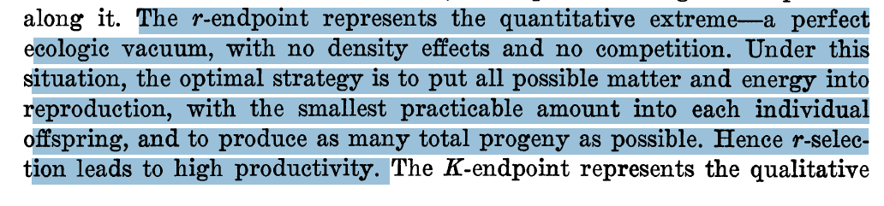
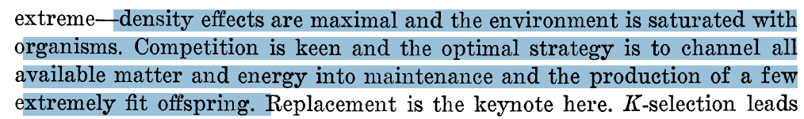
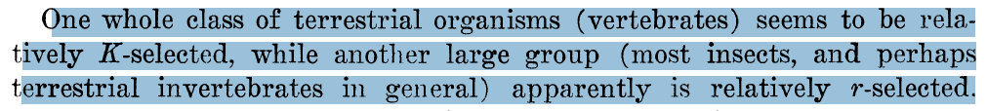

Slide 11
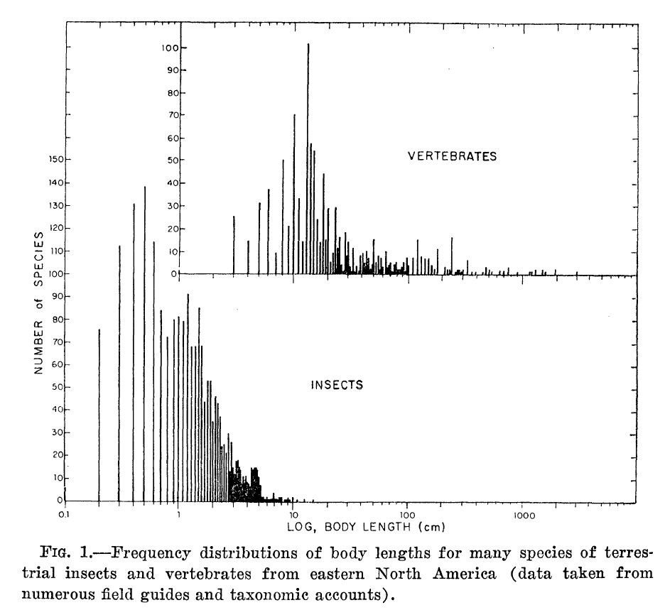
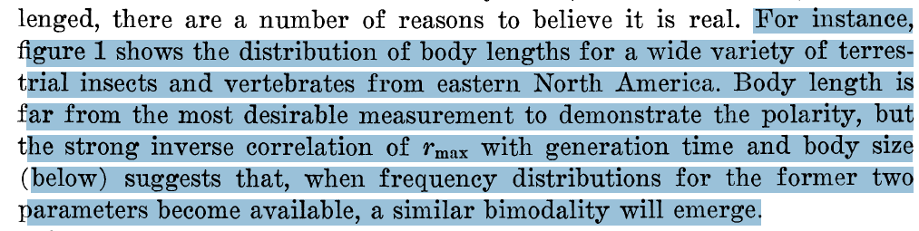

Slide 12
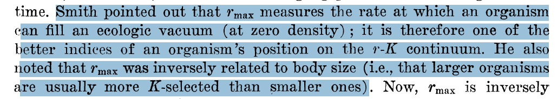
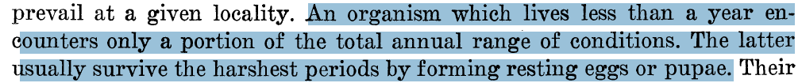

Slide 13
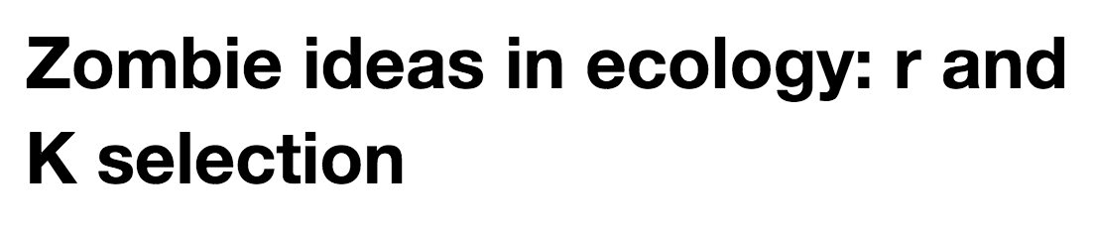
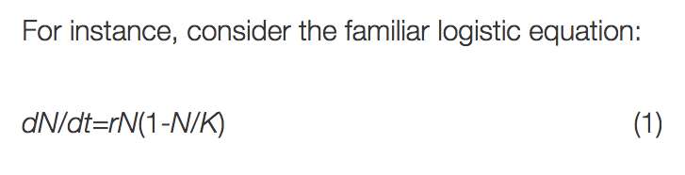
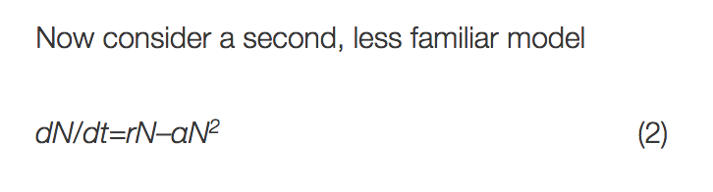
https://dynamicecology.wordpress.com/2011/06/29/zombie-ideas-in-ecology-r-and-k-selection/

Slide 14
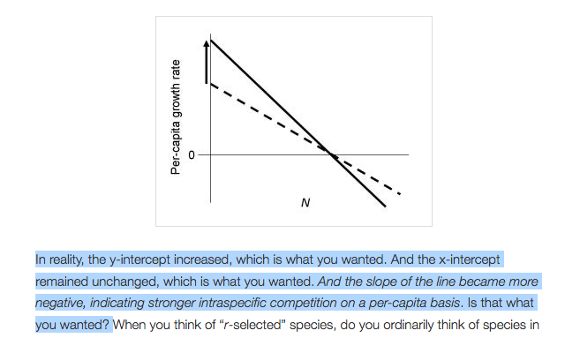

Slide 15
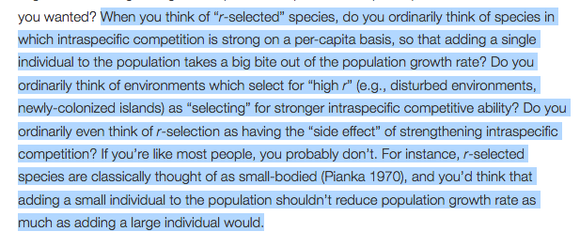

Slide 16
Logistic equation: traditional formulation
No parameter associated with competitive ability (related to the strength of density dependence)
So then high quality offspring are suggested to have higher K.
Parameters related to intraspecific competition between genotypes are missing
Motivation for density dependence was limiting resources

Slide 17
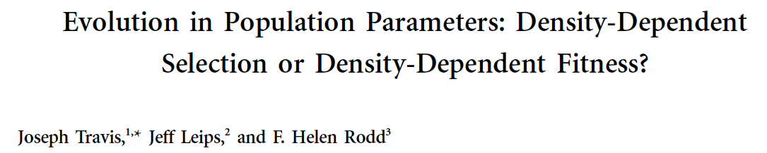
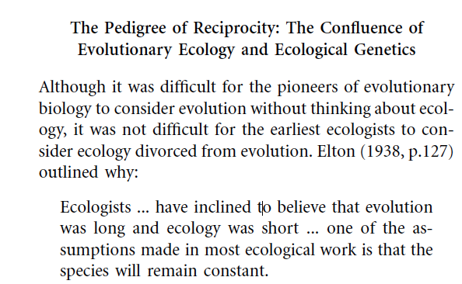

Slide 18
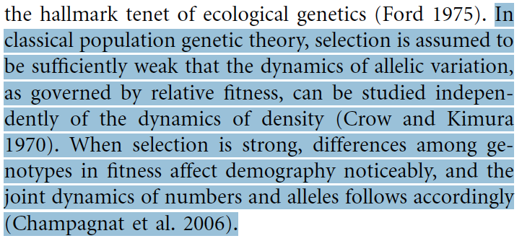
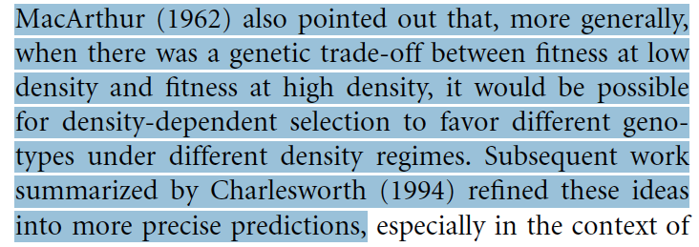

Slide 19
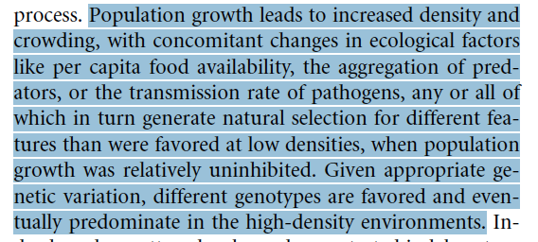

Slide 20
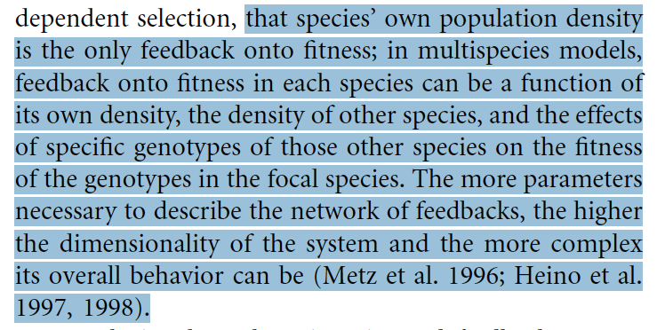

Slide 21
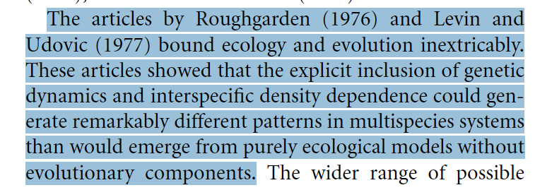

Slide 22
Carrying capacity, K, is linked to a, and
Positive relationship between K and a.

Slide 23
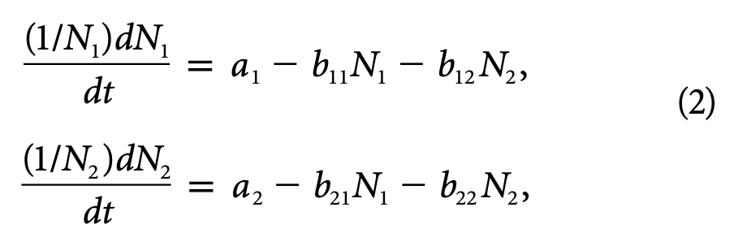
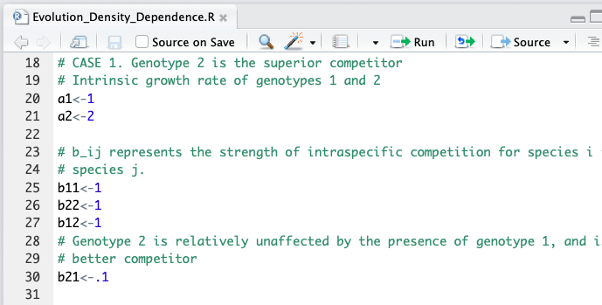

Slide 24
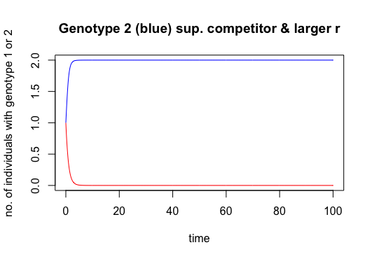
Genotype 1 (red)
Genotype 2 (blue)

Slide 25
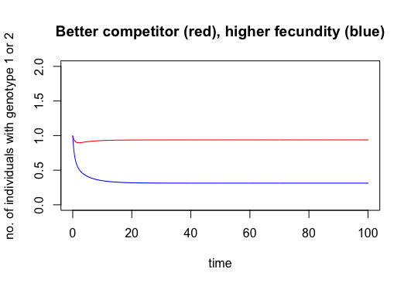
Genotype 1 (red)
Genotype 2 (blue)

Slide 26
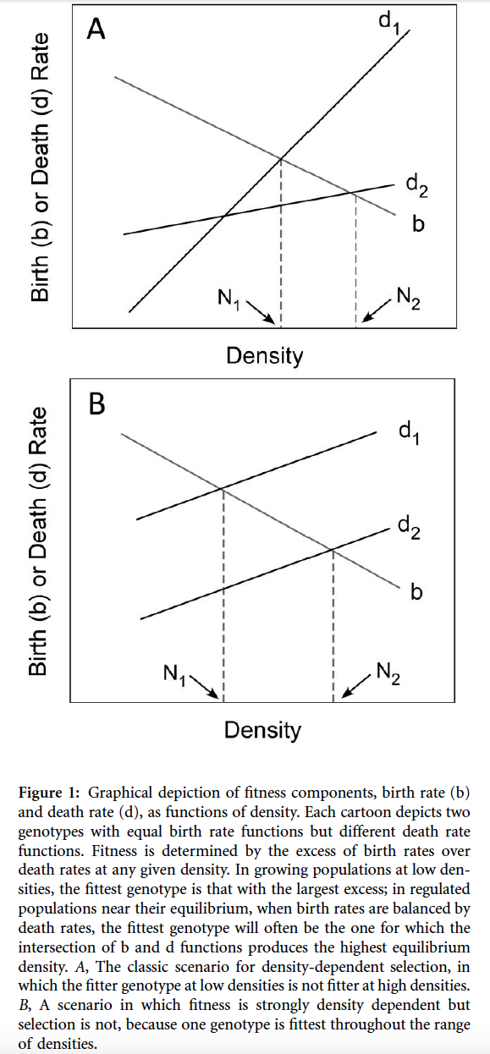
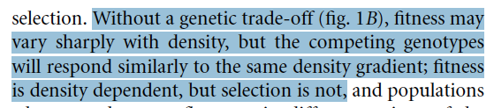
t=100
t=1
t=100
t=100
t=100
t=1

Slide 27
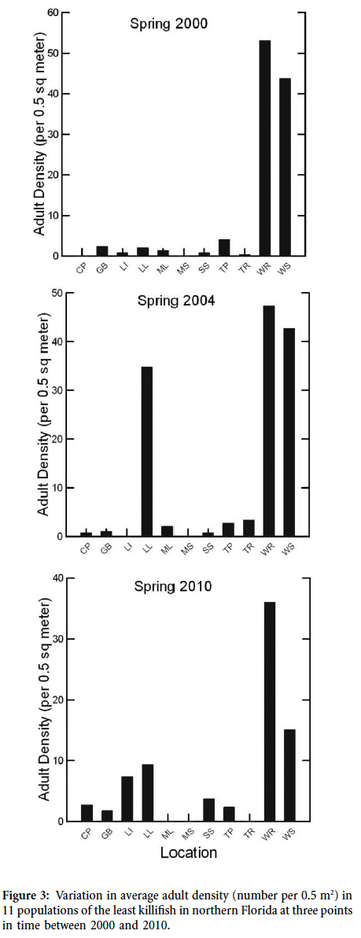
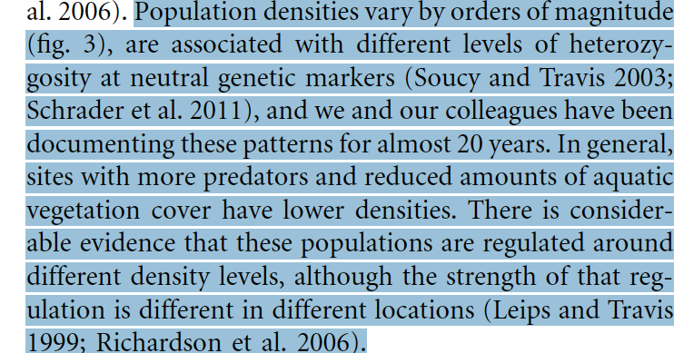

Slide 28
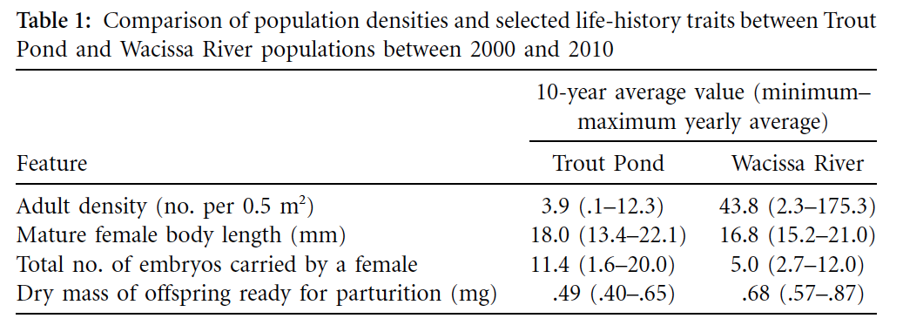
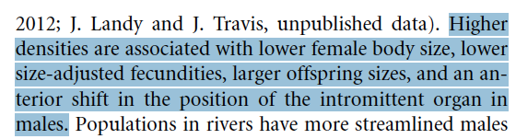

Slide 29
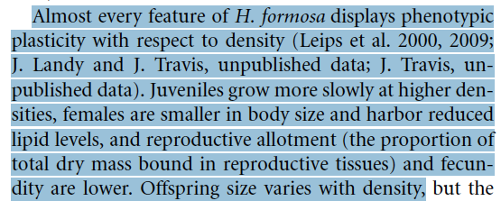
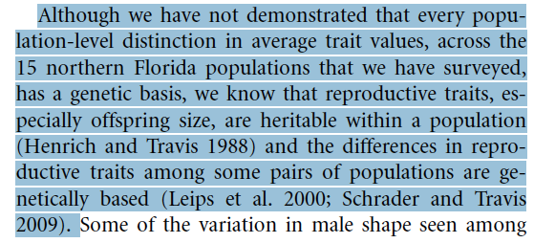

Slide 30
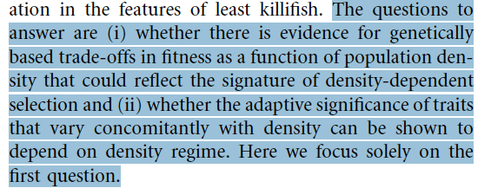

Slide 31
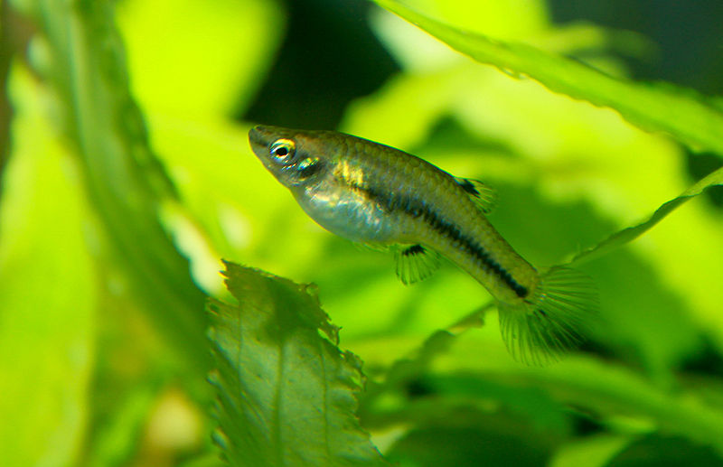
Least killish, Heterandria formosa
Brian Gratwicke [CC BY 2.0 (https://creativecommons.org/licenses/by/2.0)]

Slide 32
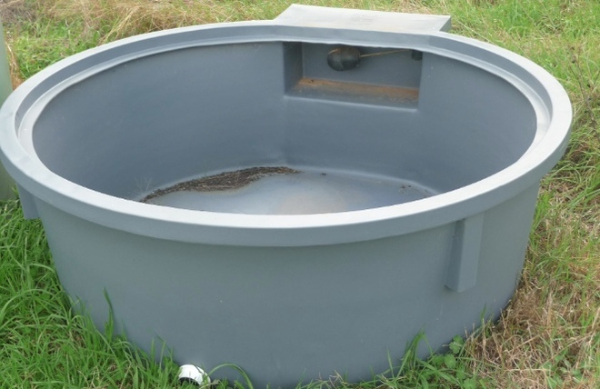

Slide 33
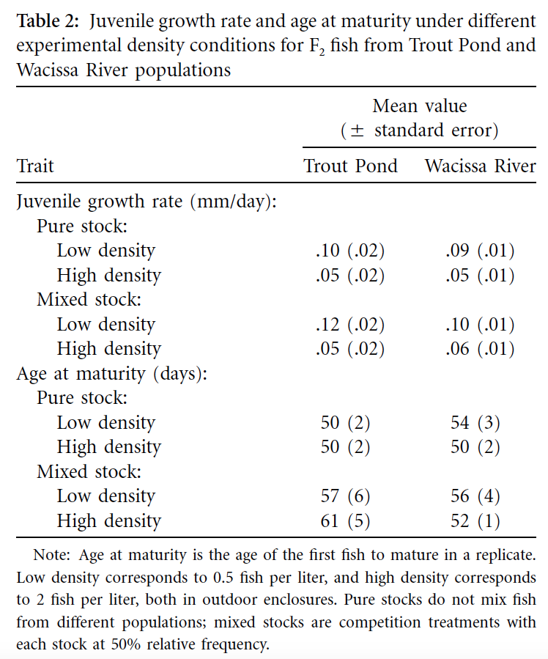
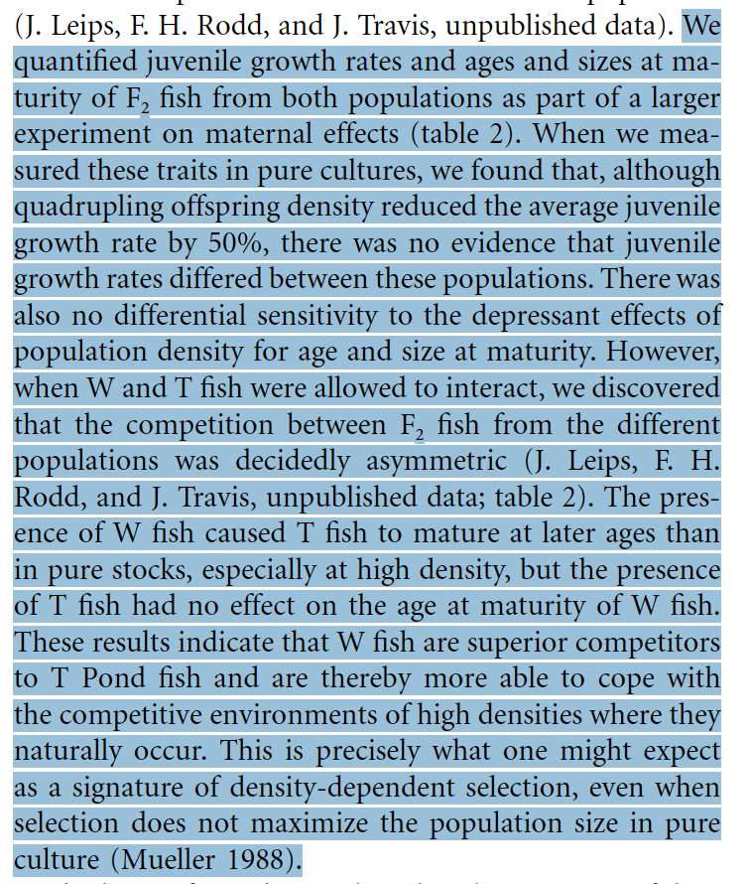

Slide 34
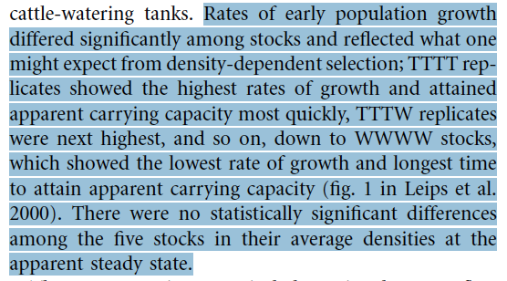
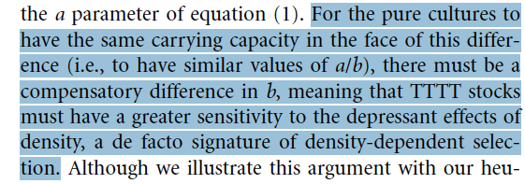

Slide 35
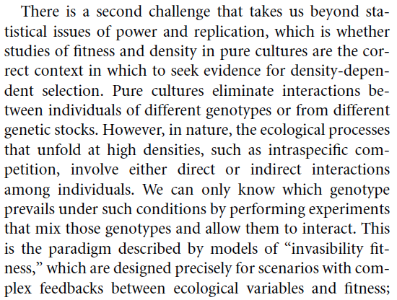
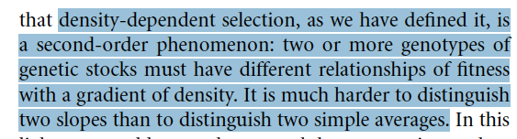

Slide 36
